Slide 1
Time Series Forecasting for Hotel Bookings
MACHINE LEARNING
Presented By – Group 3

Slide 2
Why Forecast Hotel Bookings?
❝Uncertainty in bookings affects staffing, revenue, and guest experience.❞
Business Challenge:
Inconsistent demand leads to over/under-staffing and lost revenue opportunities.
Accurate booking forecasts are essential for better planning.
Our Goal:
Build an easy-to-use forecasting tool that predicts future hotel bookings using historical data.

Slide 3
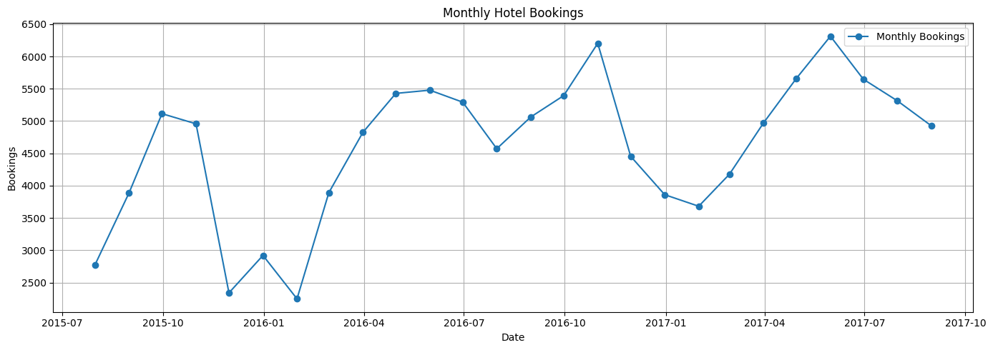
Dataset & EDA Insights
Source: Hotel Booking Demand – Kaggle Scope: Monthly bookings from 2015–2017 Features Used:
Arrival Date
Total Bookings per Month
Key Patterns Detected:
🔼 Summer spikes (June–July)
🔽 Winter slumps (Jan–Feb)

Slide 4
Understanding Seasonality & Trends
Additive
Multiplicative
Why Decompose the Time Series? To separate what’s predictable (seasonal trends) from what’s random.
Shows steady trend + consistent seasonality
Amplifies peaks and dips over time

Slide 5
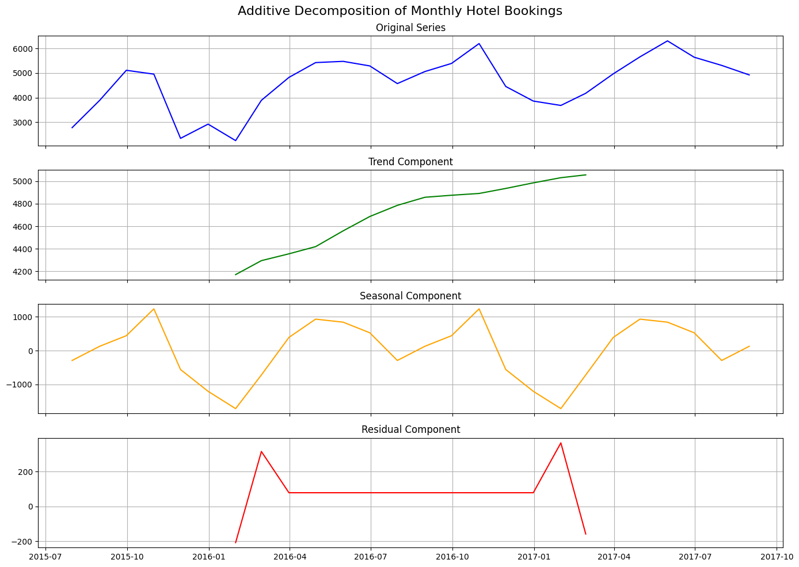
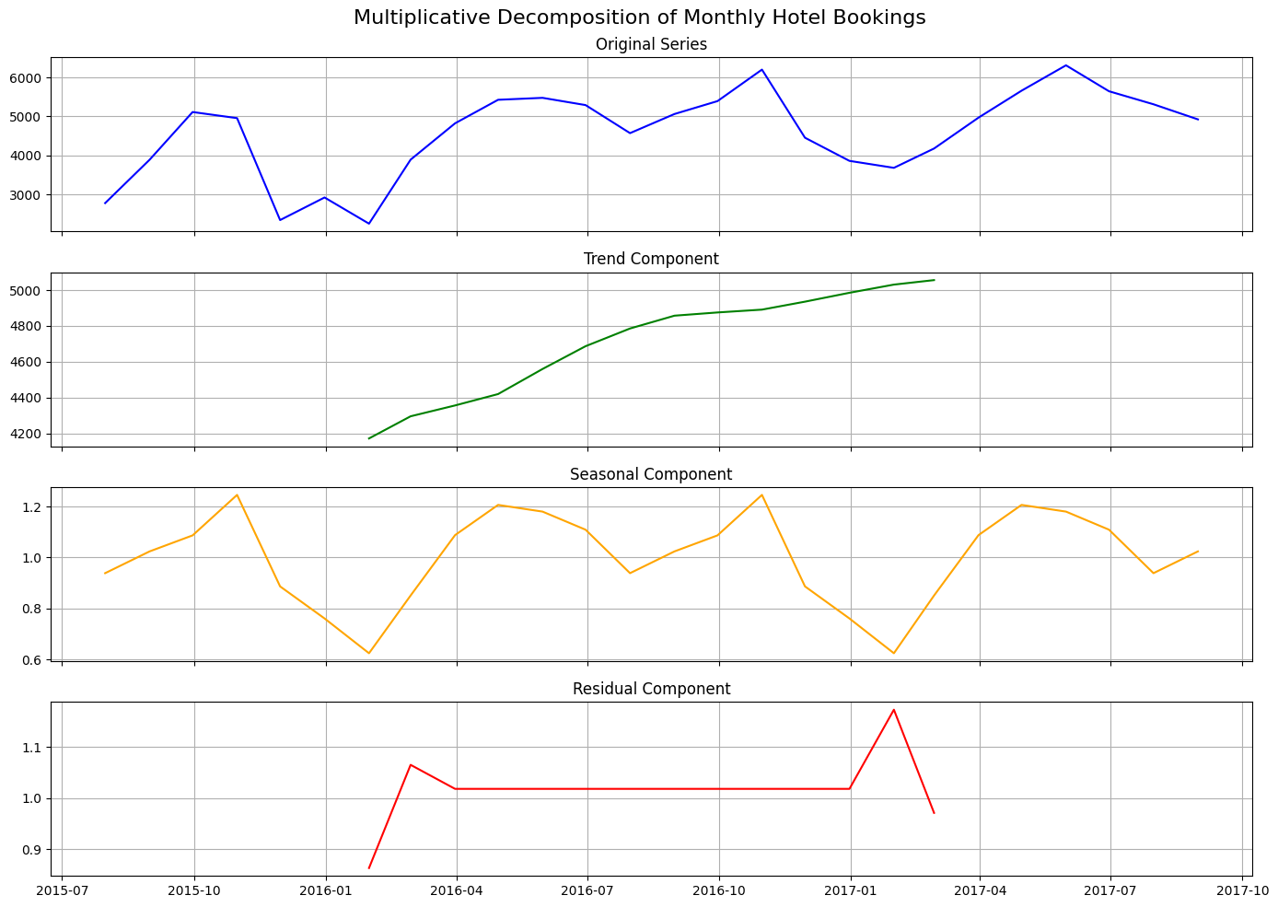
Business Insights Summer promotions and staffing can be better planned using these seasonal insights.
Additive
Multiplicative

Slide 6
Forecasting Models Compared
We evaluated 4 forecasting models:
ARIMA – Traditional statistical method
ETS – Trend and seasonality smoothing
Prophet – Business-friendly with seasonal changepoints
LSTM – Deep learning model for complex patterns
Metrics Used: ✅ RMSE | ✅ MAE | ✅ MAPE | ✅ MSE

Slide 7
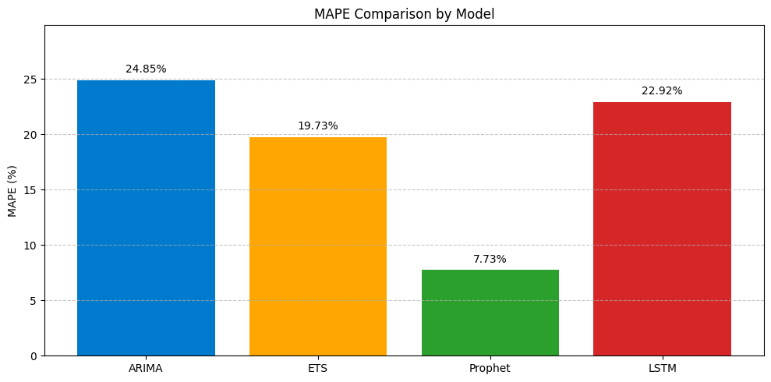
MAPE (%) Comparison by Model

Slide 8
What Worked Best?
🏆 Prophet Model – Best for long-term forecasts
Captured seasonality & shifts in demand
Accurate even with missing or irregular data
🔮 LSTM – Great for complex patterns & short-term forecasting
ARIMA & ETS: Reliable but less accurate on seasonal surges.

Slide 9
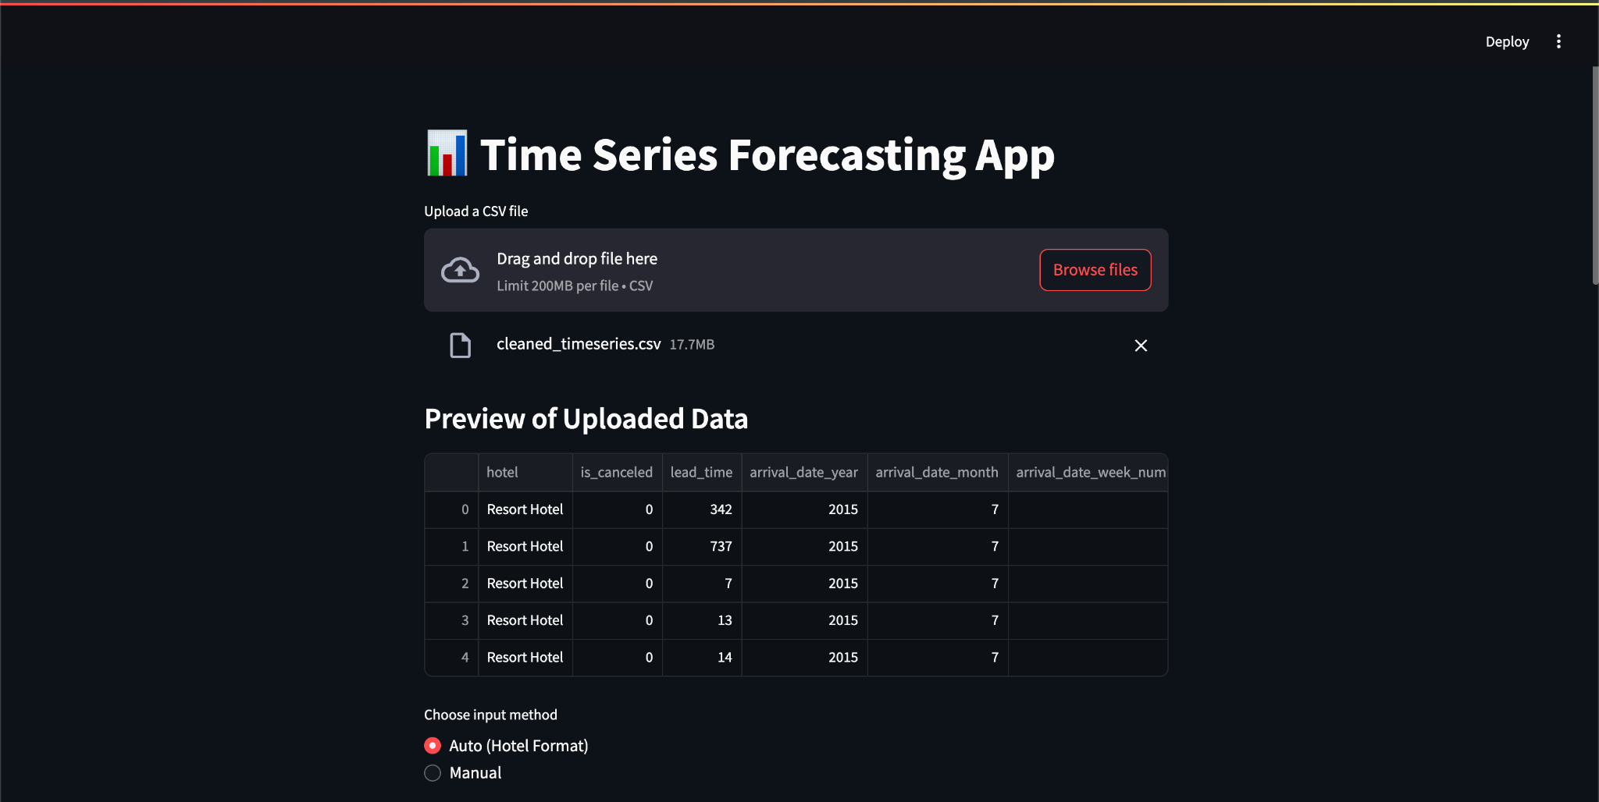
The Forecasting App
🎯 Built an interactive web app using Streamlit – no coding needed for users.
Features:
Upload CSV
Choose model & forecast horizon
View trends & forecast results
Download preprocessed data

Slide 10
Demo – App Walkthrough
Upload monthly bookings CSV

Slide 11
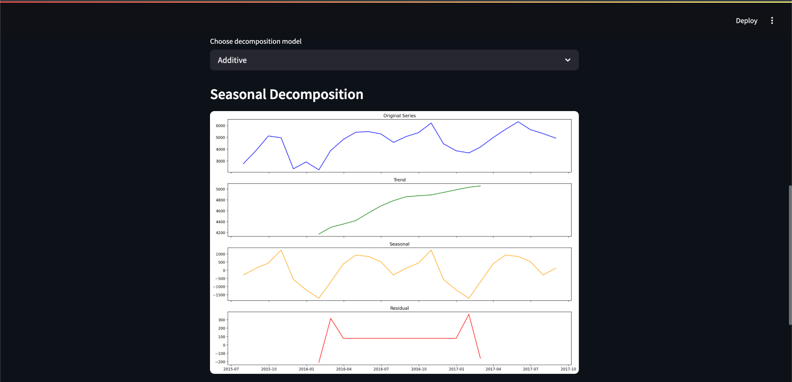
2. Choose Decomposition → Additive or Multiplicative

Slide 12
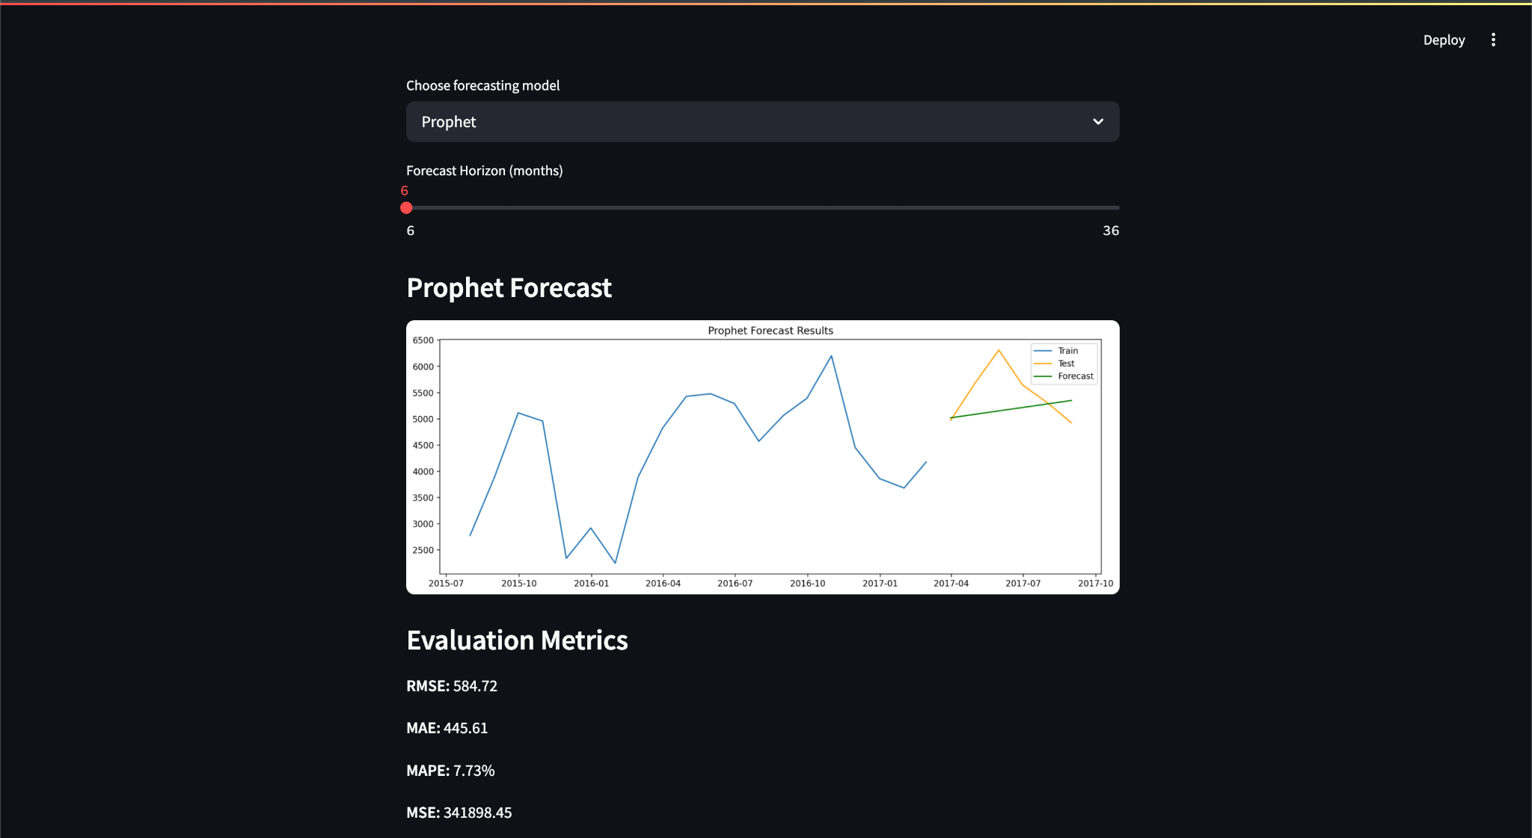
3. Select Forecasting Model (e.g., Prophet) 4. Set forecast horizon (e.g., 6 months) 5. View results

Slide 13
Deployment & Business Value
Deployed via Streamlit 🌐 Public link available – no install needed
Business Value:
🎯 Data-driven staffing & resource planning
💸 Optimized marketing campaigns in peak months
🔄 Repeatable tool for different hotels or time series

Slide 14
Final Thoughts
Key Takeaways:
Prophet model provides high-accuracy forecasts
Streamlit app makes forecasting accessible to business users
Easily extendable to finance, retail, or healthcare

Slide 15
THANK YOU!

